Slide 1
The Power of Networks Six Principles That Connect Our Lives
Chien-Chung Shen
Computer and Information Sciences
University of Delaware

Slide 2
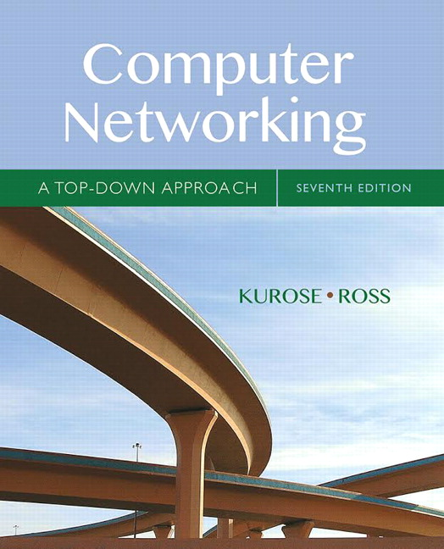
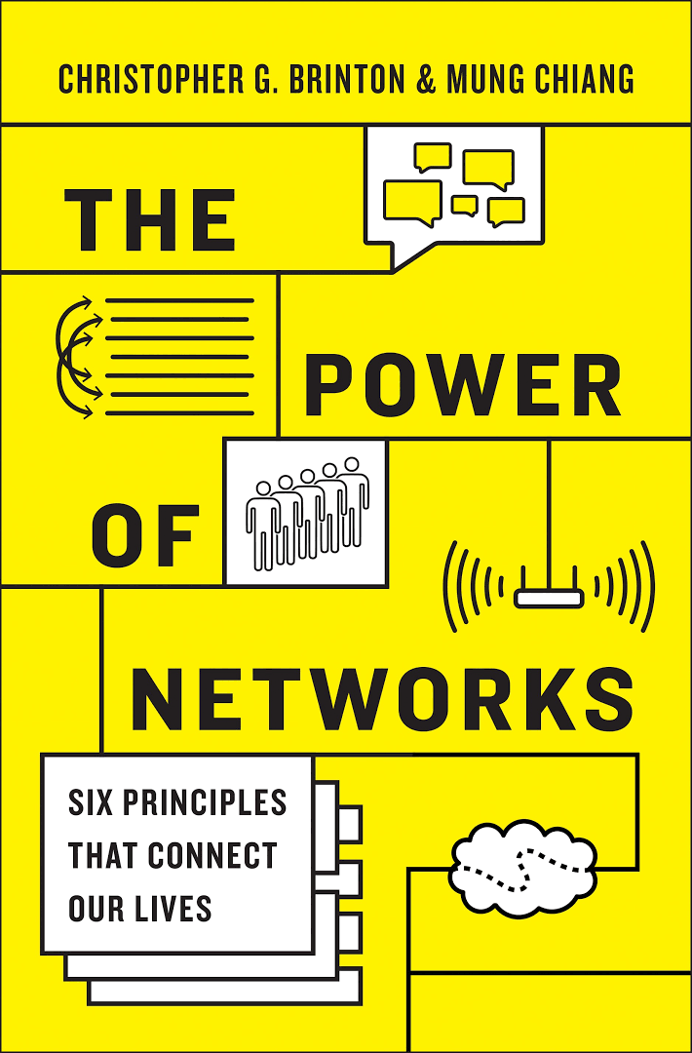
Why This Course?
social networks,
economic networks,
network services &
applications,
…….
1st edition in 2000
Computer Networks
- layers and protocols (TCP, IP, HTTP, etc.)
October 2016

Slide 3

Computer vs. Social Networks
Internet

Slide 4
Overview
“Networks” are everywhere nowadays
e.g., how our emails get carried through Internet in a matter of milliseconds
social, communication, economic, etc.
different functions: recommending movies to watch, viralizing video clips, who we are friends with on Facebook, controlling device power levels, etc.
inner workings of these functions are six hidden principles that pop up in all different kinds of networks
This course discusses these six principles of “networking” that connect our lives
via basic arithmetic (algebra)
build intuition

Slide 5
Six Principles of Networking
Sharing is hard
Ranking is hard
Crowds are wise
Crowds are not so wise
Divide and conquer
End to end
Phrases that summarize the way “networks” are designed, built, and/or managed

Slide 6
Background & Lectures
No knowledge of computer networks is needed
Basic mathematics (algebra)
Interactive lectures via questions and answers
Build intuition

